Slide 1
Project Presentation
CHARITY MANAGEMENT SYSTEM
BY : MOHIT PATHAK
B.TECH (COMPUTER ENGINEERING – CE31)
ROLL NO : 19001003065

Slide 2
INTRODUCTION & MOTIVATION
Charity is an act of kindness, where a person who has financially more than enough of what he or she needs contributes a part of his or her surplus income for the fulfilment of the needs of those who are less capable. The majority of NGOs has experienced difficulties in getting funds or other required things. Getting donor is a very hard task, and sometime dealing with some donor’s conditions can be a big challenge for NGOs to fulfil it.
This charity management system will help NGOs to find donors easily. This system has three modules namely, Admin, NGO and Donor. Admin can login using credentials and manage the request raised by NGO by approving or rejecting it. Approval will be done after verifying the NGO documents uploaded by NGO.

Slide 3
Admin will get the report of NGOs who get donations. NGOs can register and raise request by uploading NGO documents. Once admin gets the approval, they can login using credentials. NGO can raise request in need to the various registered donor. They can view the previous events list and donation report.
Donor can simply register and login using credentials. They will get the notification of the request raised by NGOs for donation. They need to fill the details regarding donation on approval of request. Donor will get the date of donation. They can also view Donation history.

Slide 4
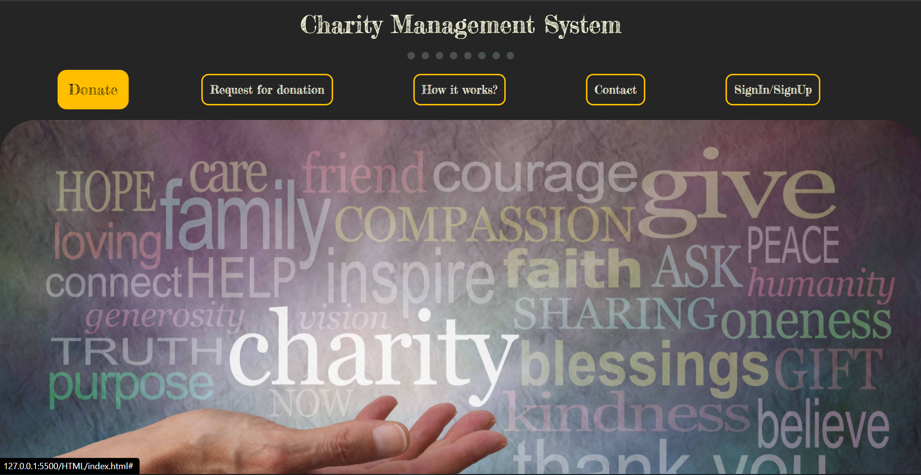
LANDING PAGE

Slide 5
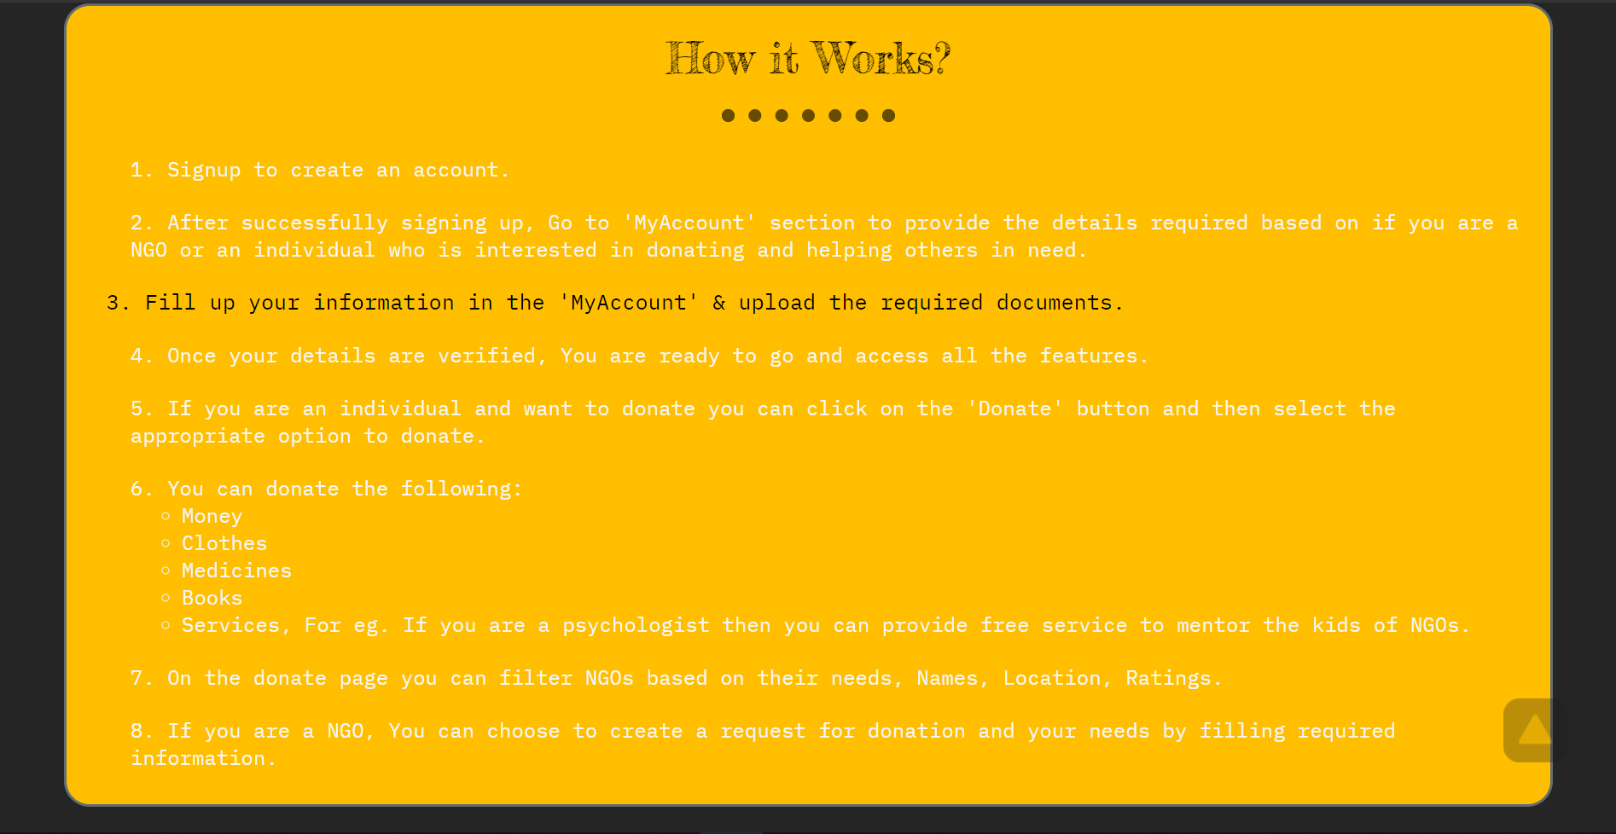
How it works?

Slide 6
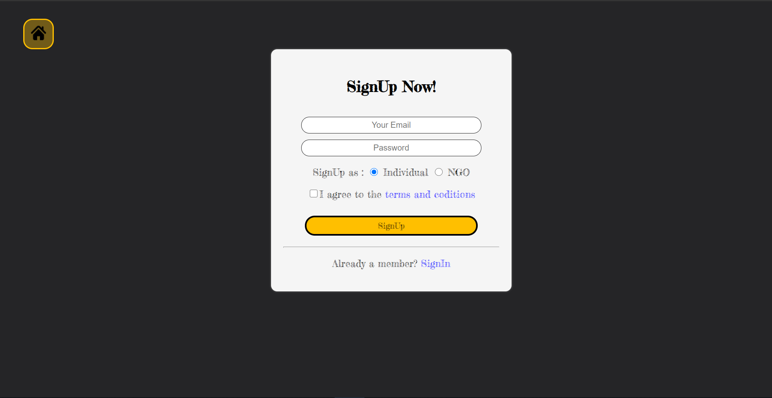
The Signup page

Slide 7
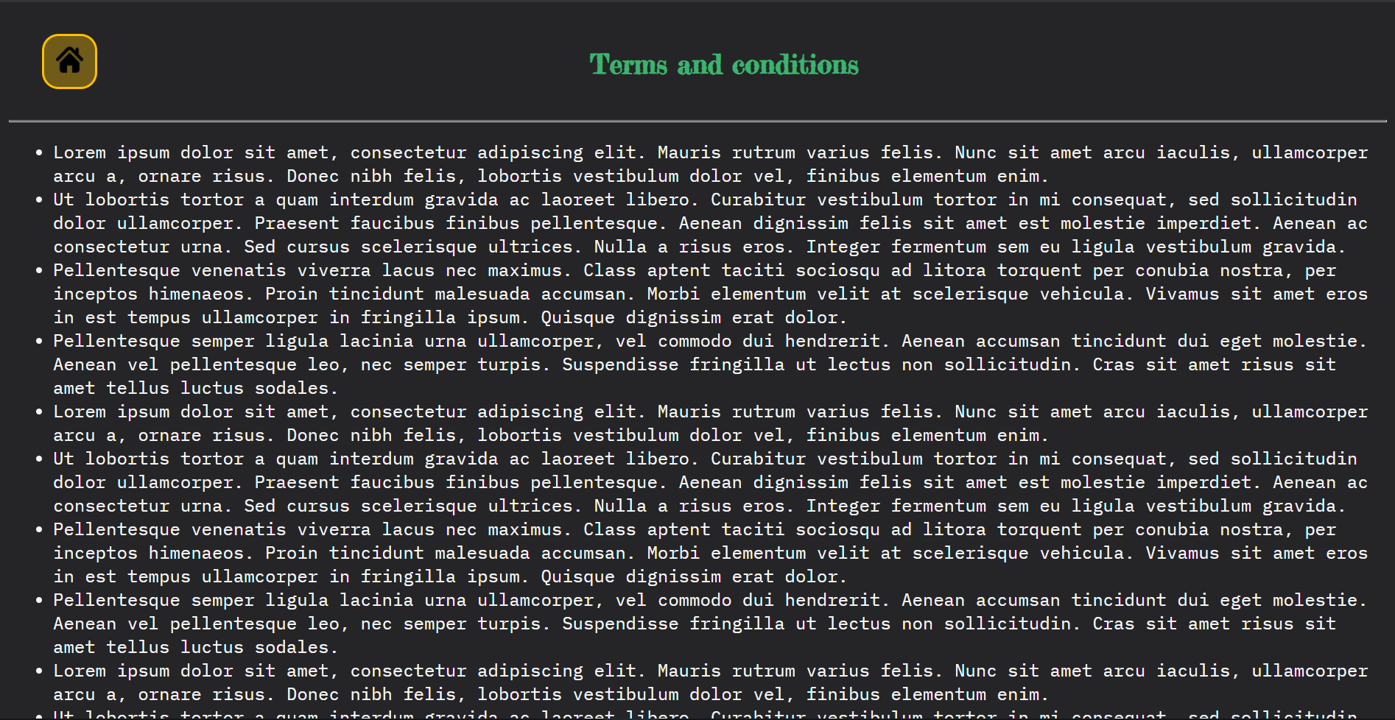
Terms and conditions

Slide 8
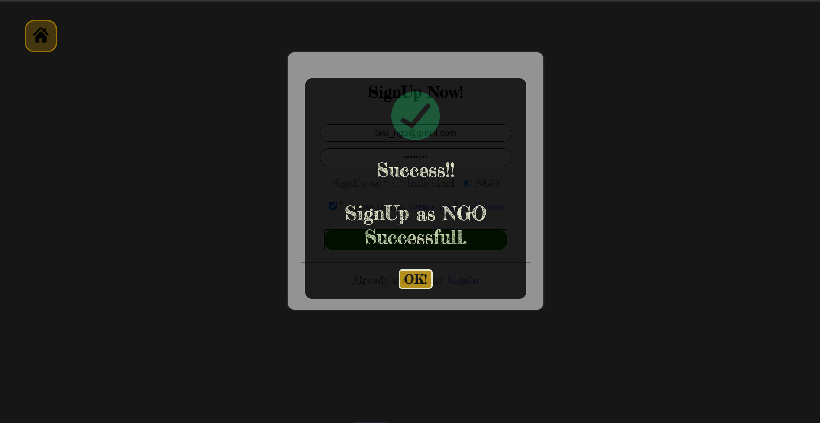
NGO or Donor SignUp

Slide 9
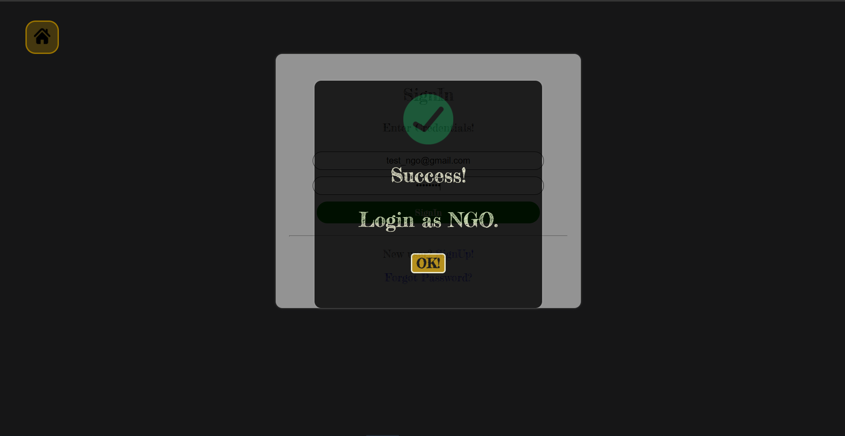
NGO or Donor SignIn

Slide 10
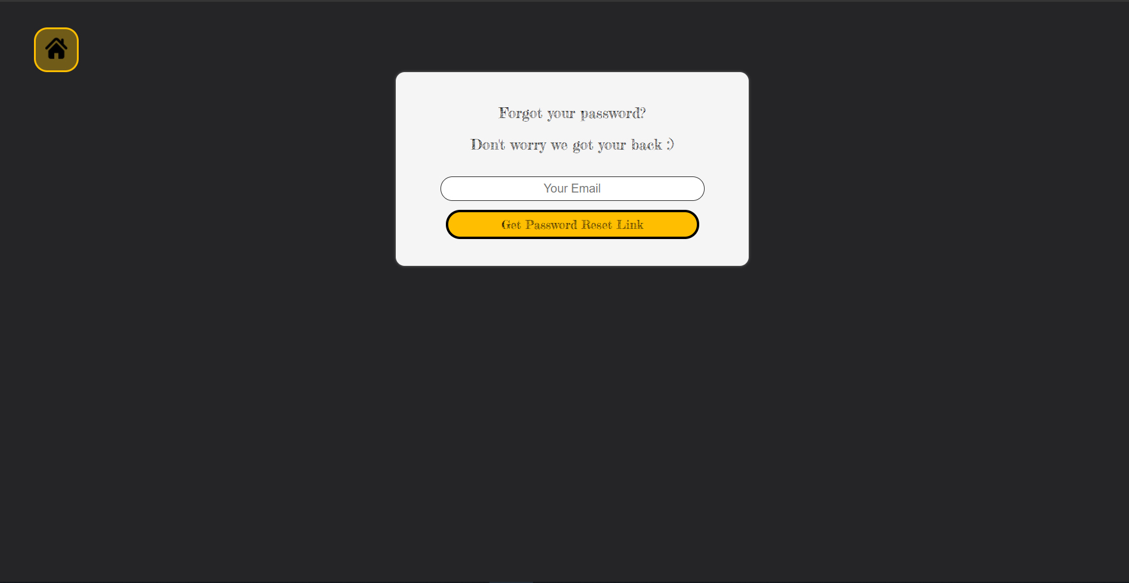
Forgot Password page

Slide 11
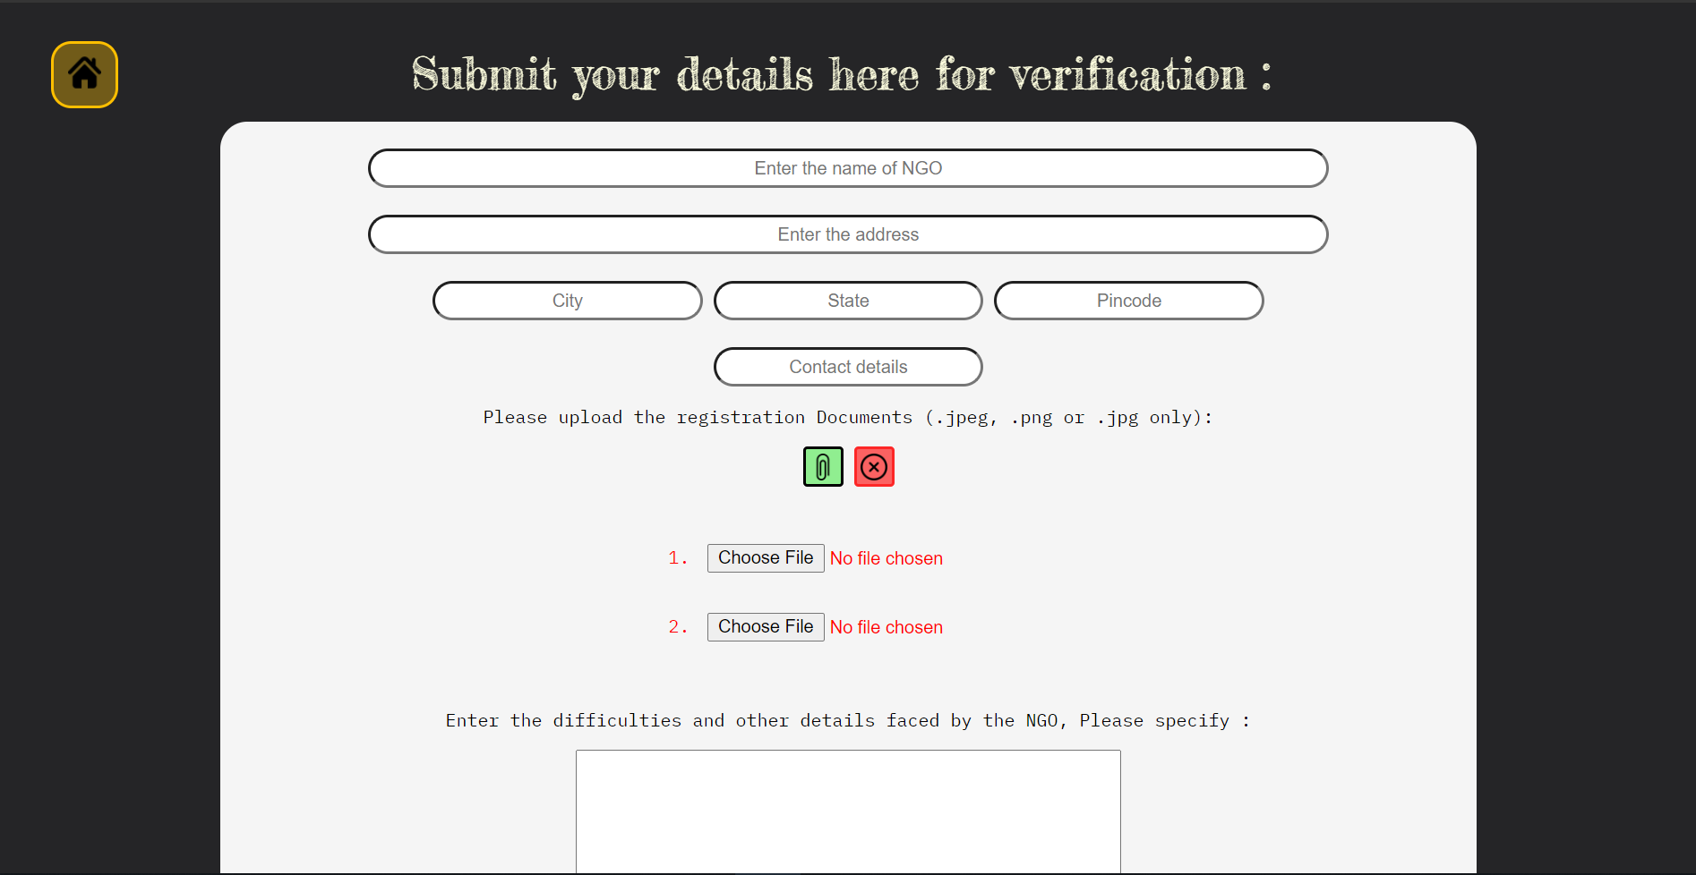
Details Submission by NGO’s or Donaters

Slide 12
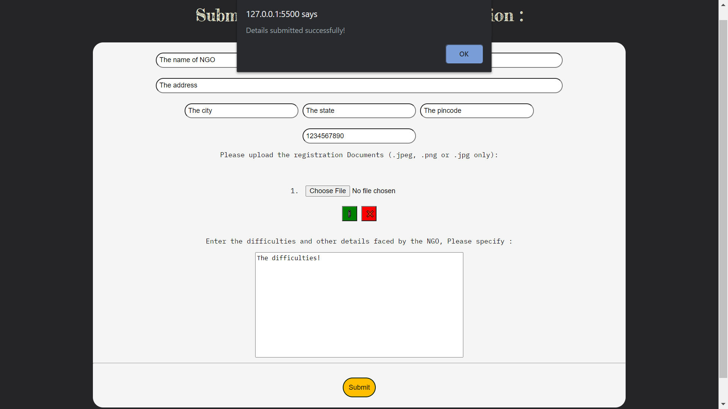
Details submission

Slide 13

Admin Signin

Slide 14
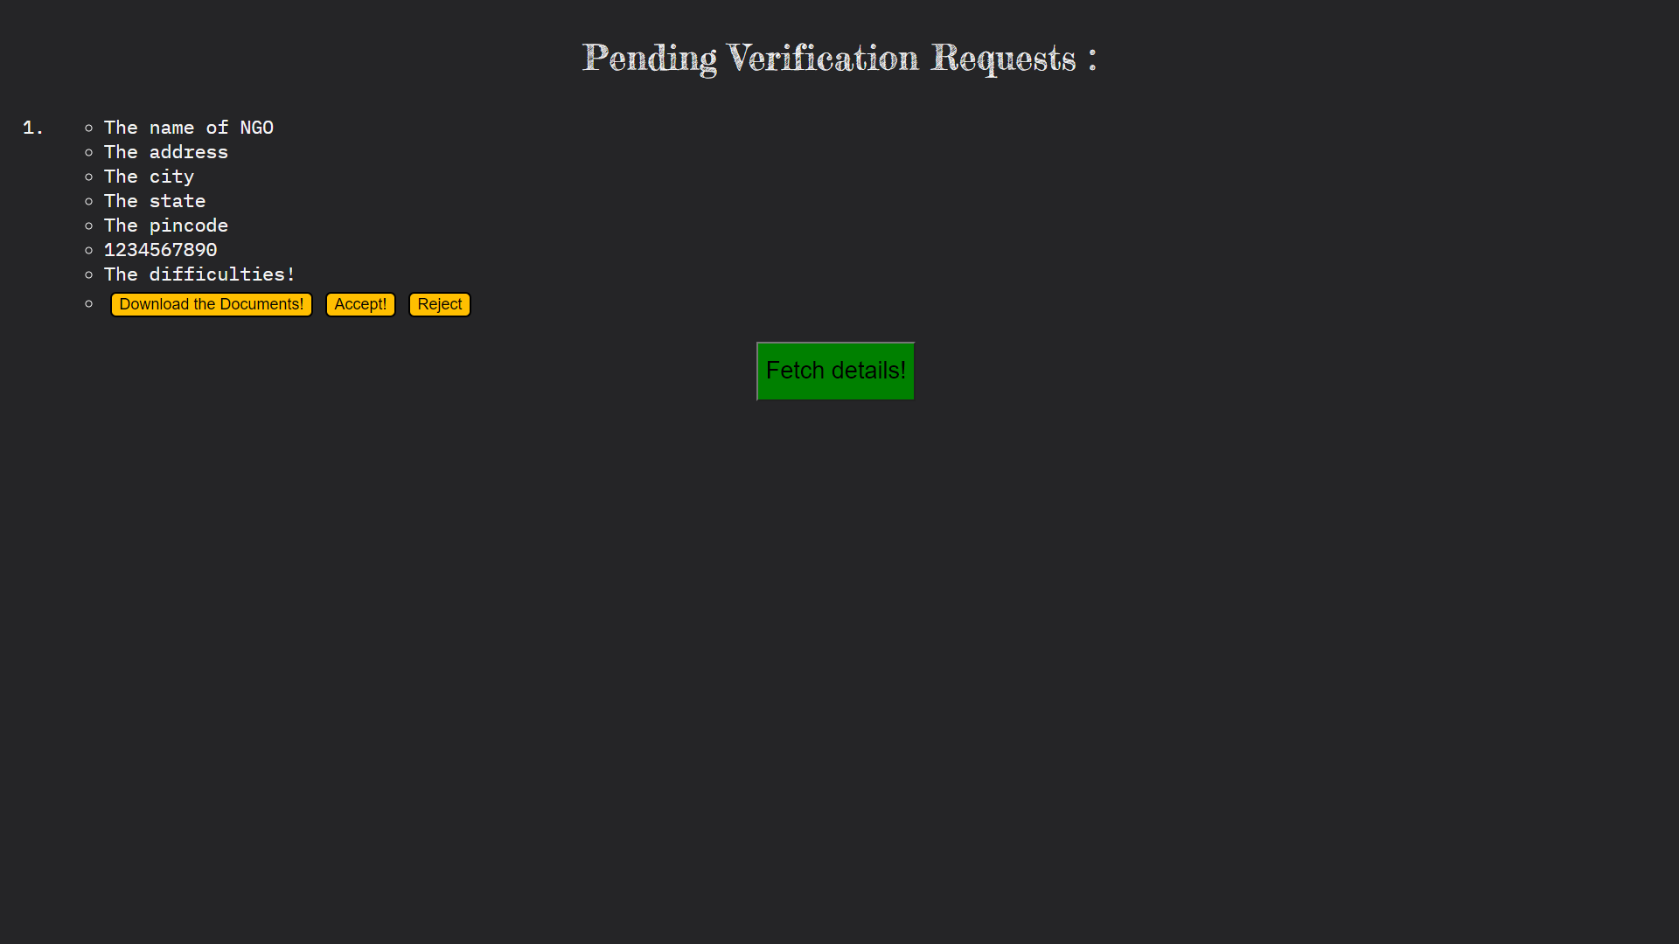
Pending Verifications

Slide 15
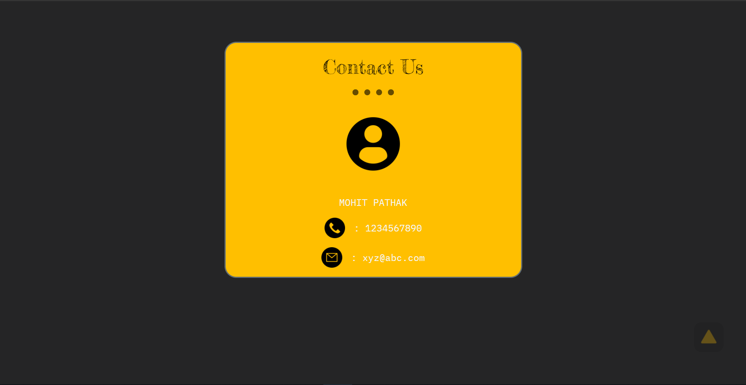
The contact details

Slide 16
Thank You

